Slide 1
DIFF-NST: Style transfer with Diffusion models
Dan Ruta, Gemma Canet Tarrés, Andrew Gilbert, Eli Shechtman, Nicholas Kolkin, John Collomosse

Slide 2
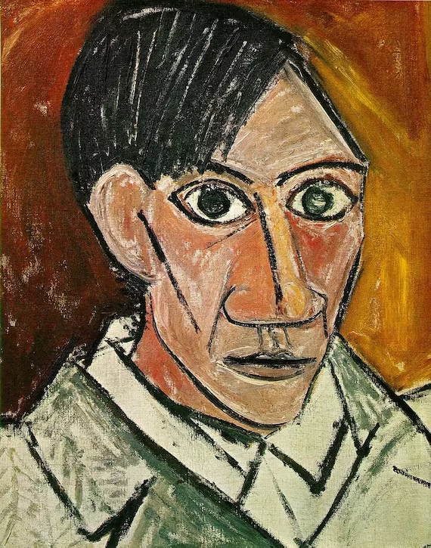


End of 2nd year - Dan Ruta
DIFF-NST: Style transfer with Diffusion models
Styles can focus on the form of its subject matter, rather than its rendering style
This aspect of style hasn’t been explored as much in NST literature
Notes:
The driving observations of this project are that the focus of certain styles is on the content deformation. A key example is Picasso’s cubist style, which is primarily focused on the way the content is shaped, rather than the rendering style. To date, NST has placed great importance on the texture of a stylization. With the advent of diffusion models, we can tap into the learnt world model across vast amounts of artwork styles, to see if we can achieve stylization at a higher level, such as this.

Slide 3
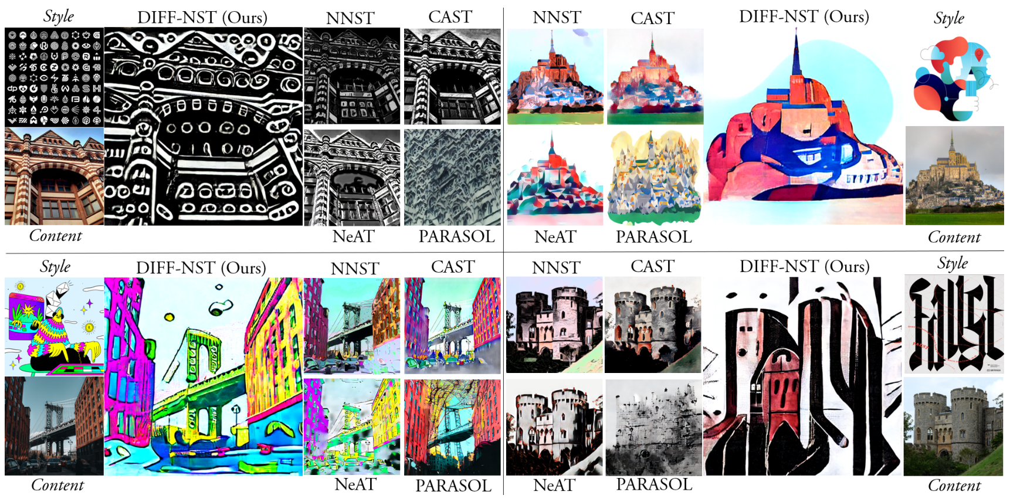
DIFF-NST: Style transfer with Diffusion models
End of 2nd year - Dan Ruta
DIFF-NST: Style transfer with Diffusion models
Notes:
This project achieves zero-shot feed-forward text-free exemplar-based style transfer using pre-trained diffusion models such as Stable Diffusion, through attention manipulations learned with small auxiliary modules. It also achieves form deformation in style transfer, a capability elusive to previous literature.
A common limitation with neural style transfer is that typically, the best that these models can do, is change the colours and textures of the content image, to match those of the style image. But artistic style means much more than just those two things. You also have artistic styles which focus on the deformation of the subject matter being depicted.
These kinds of artistic form changes have been difficult if not impossible to achieve with previous NST work in a general way, and it is this that we especially aimed to achieve in this project. The thinking is, that to be able to achieve such edits, a model needs to have a really good understanding of the world - some sort of world model. And this capability was quite evident in these text-to-image generative models. You would often see correct reflections in generated images, good object proportions, good relative placements of objects, and things like that.

Slide 4
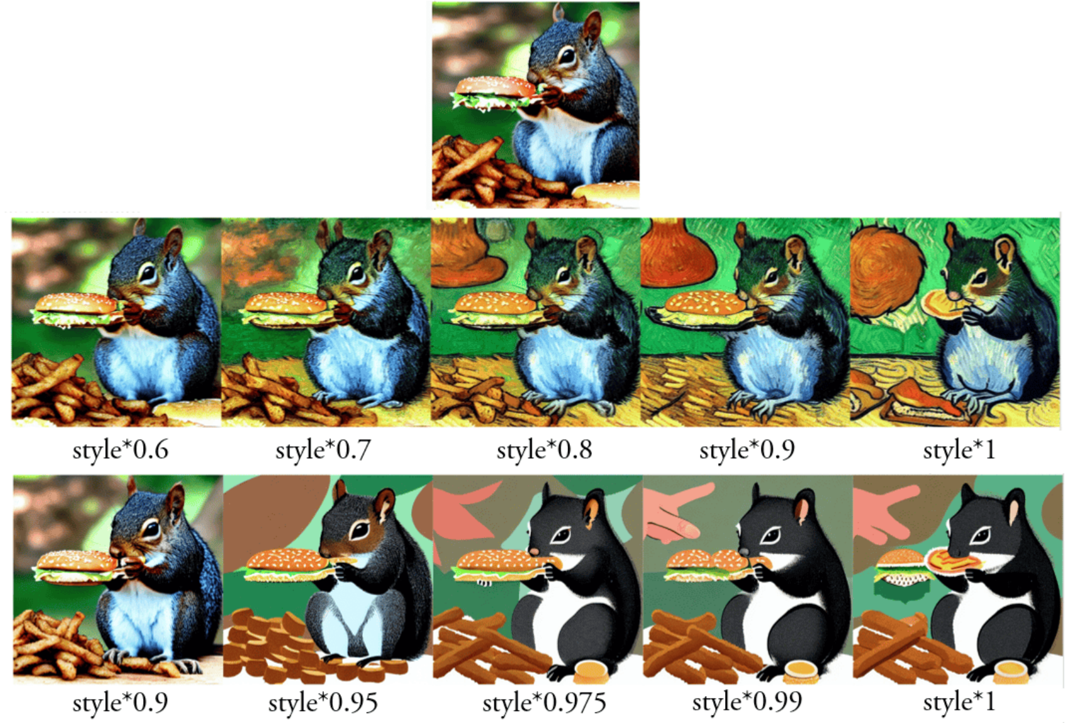
Preliminary experiments with prompt-to-prompt
End of 2nd year - Dan Ruta
DIFF-NST: Style transfer with Diffusion models
Generated many pairs of content and stylized images
Analysed the differences in latent values
Most changes occur in the V attention values
Notes:
So we started by exploring the prompt-to-prompt technique, which is a technique which allows editing generated images, through prompt modifiers. So for example, "a squirell" can be changed to "a squirell in the style of van gogh", and it would re-generate that same squirell but with a different style. We studied and examined the differences in latent attention space, to verify the initial hypothesis - that most of the style information is found in the V values in the self-attention.
We targeted self-attention instead of cross-attention like other works, because neural style transfer, as we know it, is exemplar-based. So, using a reference style image, rather than a text prompt describing the style. And cross-attention brings text prompt information into the diffusion process, whereas self-attention uses only the information propagated through the diffusion process (the image being generated).

Slide 5
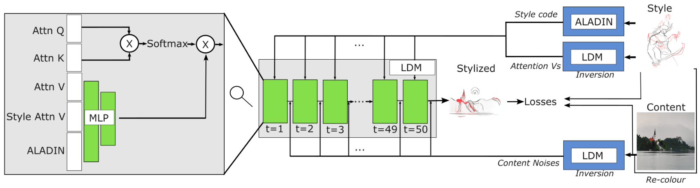
DIFF-NST: Style/Content inversion and injection
End of 2nd year - Dan Ruta
DIFF-NST: Style transfer with Diffusion models
Invert the content image through injecting the noises
Inject the style information via the V attention values, and ALADIN style code
Notes:
There were several design decisions* to consider for the project, to actually make it work, but the overall simple idea was to use the frozen SD weights, and the content and style data from our BBST-4M dataset, and to train a number of small modules to perform attention manipulation, over those V values.
We injected the structure of the real image data by performing DDIM inversion. As for the style, I inverted the style image also, and extracted the V values from the self-attention, during its reconstruction. I took both the content noises and the style attention V values and injected them into the stylized image reverse diffusion generation process.
The trainable modules are small MLPs in each self-attention block, which generate brand new attention V vectors for the self-attention, based on the existing self-attention V, the attention V from the style image at this location and timestep, and also the ALADIN style code. This process also works if only using the ALADIN code for style information, or if only using the style attention V for style information. However, using both leads to higher quality, as it introduces both global AND local style information.
For training, we un-rolled the diffusion process over 50 timesteps, and applied some standard NST losses over the final generated image. So we run the inversions, and step through all 50 timesteps, decode the final stylized image, where we can apply a style loss. And we back-propagate the loss back through all the timesteps.

Slide 6
DIFF-NST: Unconditional generation
End of 2nd year - Dan Ruta
DIFF-NST: Style transfer with Diffusion models
Only unconditional branch is executed
No text prompts are used at any point in the process
Notes:
One thing to clarify, is that DIFF-NST performs style transfer using an exemplar style image. So only the style image is provided for style information. And only the content image is provided for the content information. No text prompts are used anywhere in the process. We don’t want to use text prompts for style transfer, because text is a very coarse way to communicate style, and fully describing the style information of an image is difficult if not impossible. An image is still worth 1k words.
We use Stable Diffusion as the backbone diffusion model, which IS a text-to-image model. But that model is actually executed twice for any standard text-to-image generation. Once using text prompt information conditioning, and once in an unconditional way without text prompt conditioning. The values from both executions are merged via the classifier free guidance.
But seeing as we’re avoiding text prompts, we actually don’t need to even run the conditional branch of the model - so we don’t. We disable it and only use Stable Diffusion in an unconditional way. This is the same as setting CFG to 0, and the same also works if you freeze a generic prompt for every single operation. But for compute speed and memory constraints, we disable the conditional branch altogether. We also use some other tricks for speed/memory, including some from the ControlNet paper.

Slide 7
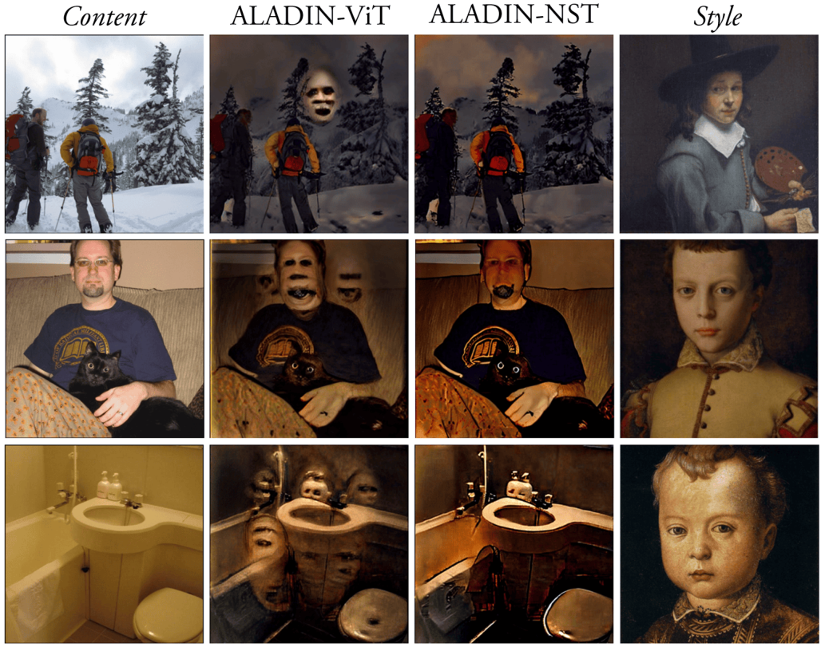
ALADIN-NST for avoiding semantic creep
End of 2nd year - Dan Ruta
DIFF-NST: Style transfer with Diffusion models
Strong disentanglement in ALADIN-NST avoids encoding strong semantic information such as faces into the stylization
Notes:
An edge failure case with this approach is the creep of some strong semantic features such as faces, into the stylized output. This occurs due to content entanglement in the style embedding. But by using our much more strongly disentangled ALADIN-NST embedding, this issue can be fixed.

Slide 8
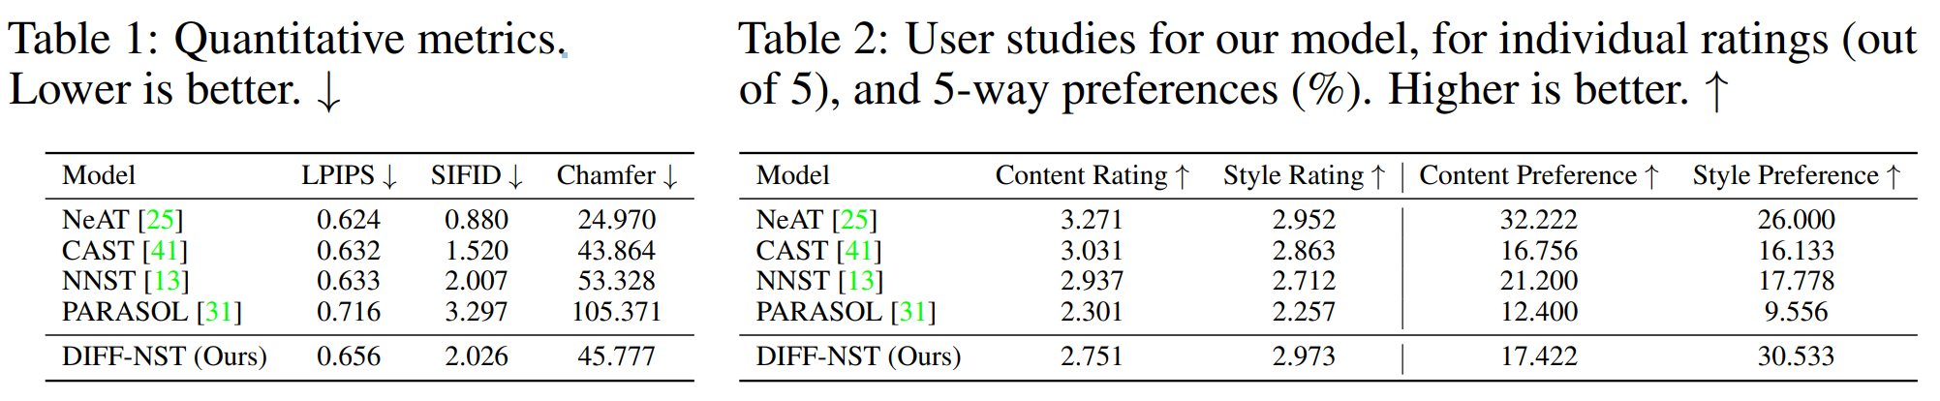
Quantitative results
End of 2nd year - Dan Ruta
DIFF-NST: Style transfer with Diffusion models
Competitive results - despite the metrics not capturing high level deformation changes
We score high on style ratings in user studies
We score low on content ratings in user studies
Note, this is good, as we are not aiming to re-create the content details
Notes:
We achieve highly competitive metrics, when compared to our baseline methods. We are not state of the art, though it must be noted that these automated metrics do not capture high level semantic deformations, which is the strength of our work.
We also evaluate through user studies, for overall preference of content or style, as well as through categorized ratings of various definitions of content and style. In both cases, we perform the best for style, and among the worst for content. Note that a low score for content is desirable, as we are deforming the content.

Slide 9
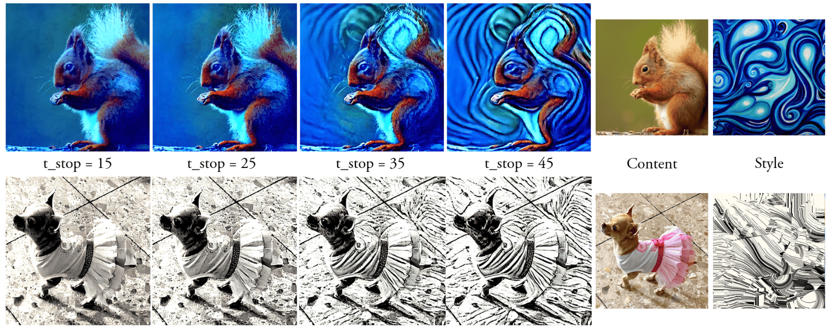
DIFF-NST stylization strength control
End of 2nd year - Dan Ruta
DIFF-NST: Style transfer with Diffusion models
Limiting the timestep until the style attention V and ALADIN code is interleaved into the diffusion
Notes:
One of the ways the stylization can be controlled at inference-time is stylization strength. This controls how strongly the style is applied to the image. We can control this through limiting the LAST timestep at which the style information is interleaved into the diffusion process. That being the style attention values and the ALADIN codes. Interleaving them until a later timestep introduces more style information.

Slide 10
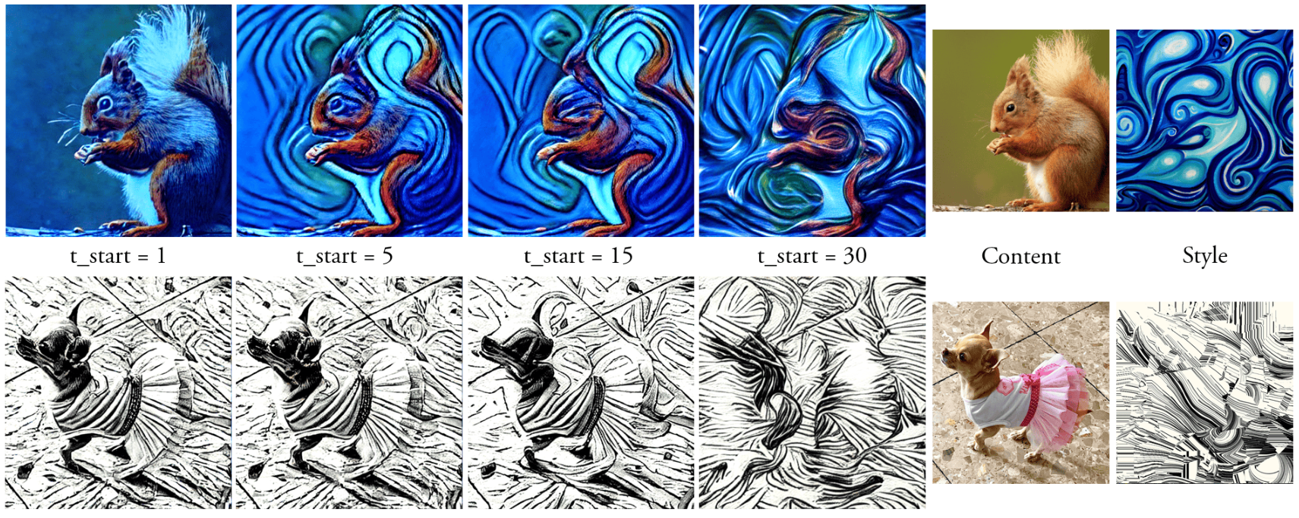
DIFF-NST deformation control
End of 2nd year - Dan Ruta
DIFF-NST: Style transfer with Diffusion models
Delaying the starting step for noise injection controls how much the style will deform the content
Notes:
The other inference-time control is content deformation. This is a capability which is unique to DIFF-NST.
This is a control for how strongly we can allow the style to affect the structure of the content in the stylized image. This can be controlled by delaying the STARTING timestep in the reverse diffusion process at which the inverted content noises are injected.
If you inject content noises from very early on, you can mostly reconstruct the content image, with most of the details, as expected. But if you hold back the content noises for more and more timesteps, the only information the diffusion process will have, is the style information which is also interleaved. Being an unconditional diffusion, the generated image will resemble structure components similar to the style image.

Slide 11
DIFF-NST: Style deformation
End of 2nd year - Dan Ruta
DIFF-NST: Style transfer with Diffusion models
Notes:
Going back to this figure - here we can see how DIFF-NST quite strongly demonstrates the deformation capabilities, compared to previous state-of-the-art NST techniques, including NeAT. Previous works tend to mainly adjust small things here and there in the content image, whereas DIFF-NST completely re-imagines the image, heavily making use of style information from the style image, in the composition, structure, and details of the image.

Slide 12
Conclusions
End of 2nd year - Dan Ruta
DIFF-NST: Style transfer with Diffusion models
Explored an application of NST with pre-trained diffusion models
Enabled controllable deformation in NST for the first time
The abstraction of content can be controlled by the timestep of content information injection
Style strength can be controlled by the timestep of style information injection

Slide 13
Thank you
End of 2nd year - Dan Ruta
DIFF-NST: Style transfer with Diffusion models

Slide 14
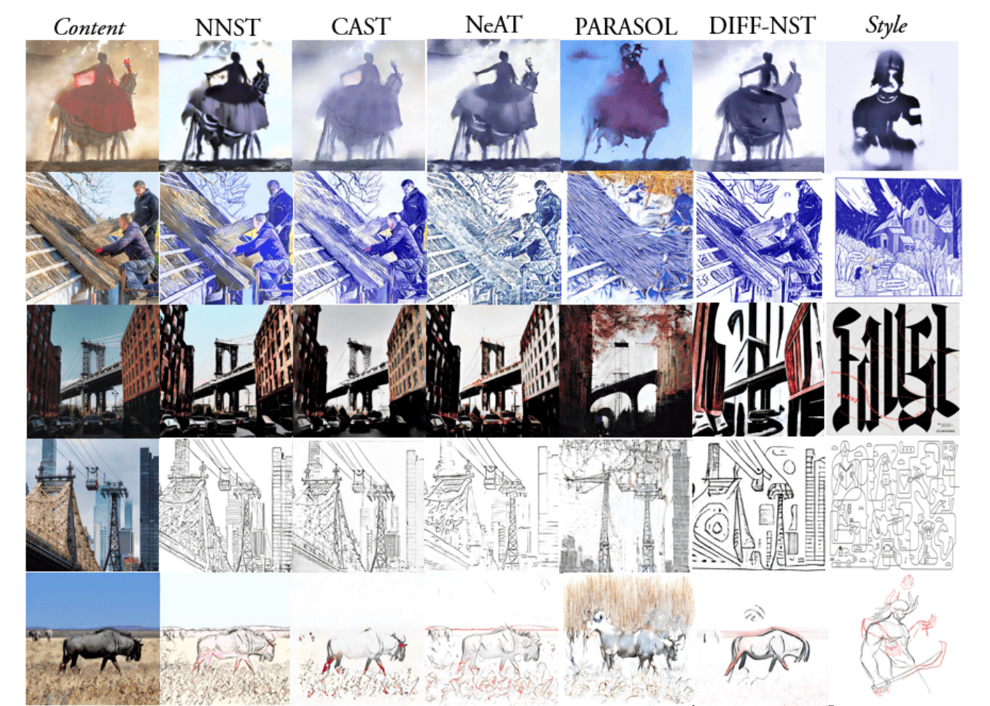
End of 2nd year - Dan Ruta
DIFF-NST: Style transfer with Diffusion models

Slide 15
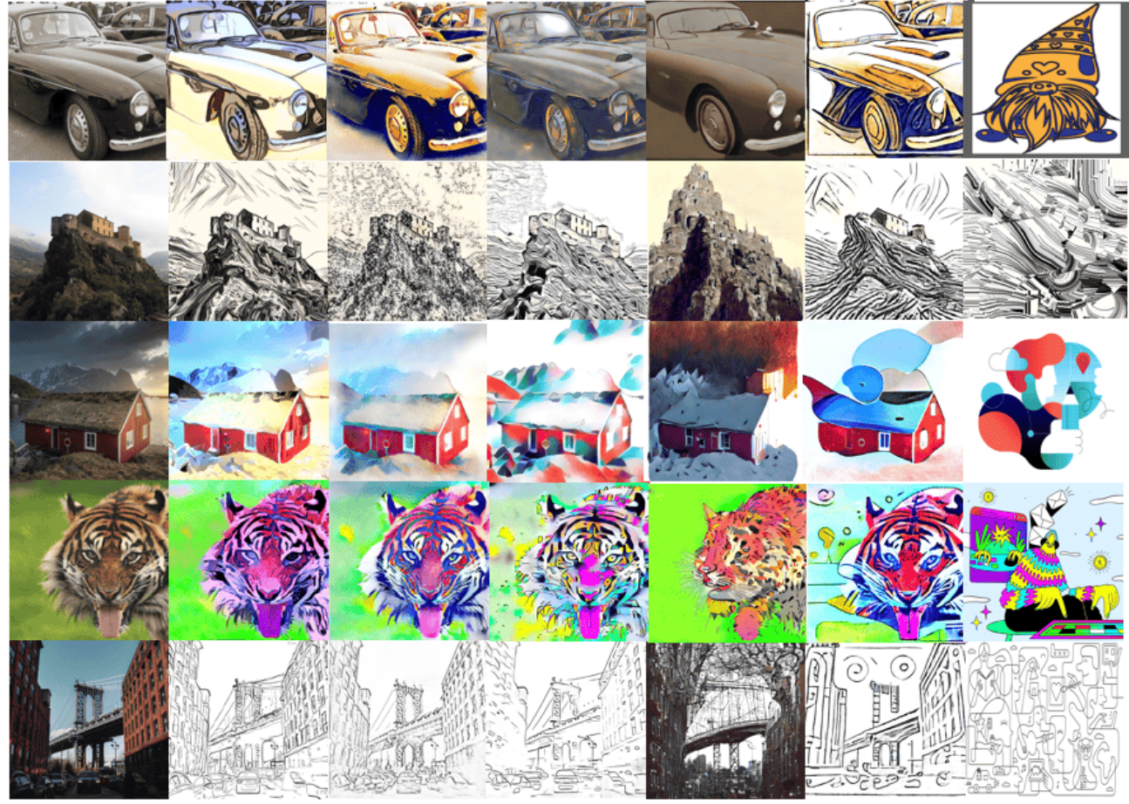
End of 2nd year - Dan Ruta
DIFF-NST: Style transfer with Diffusion models

Slide 16
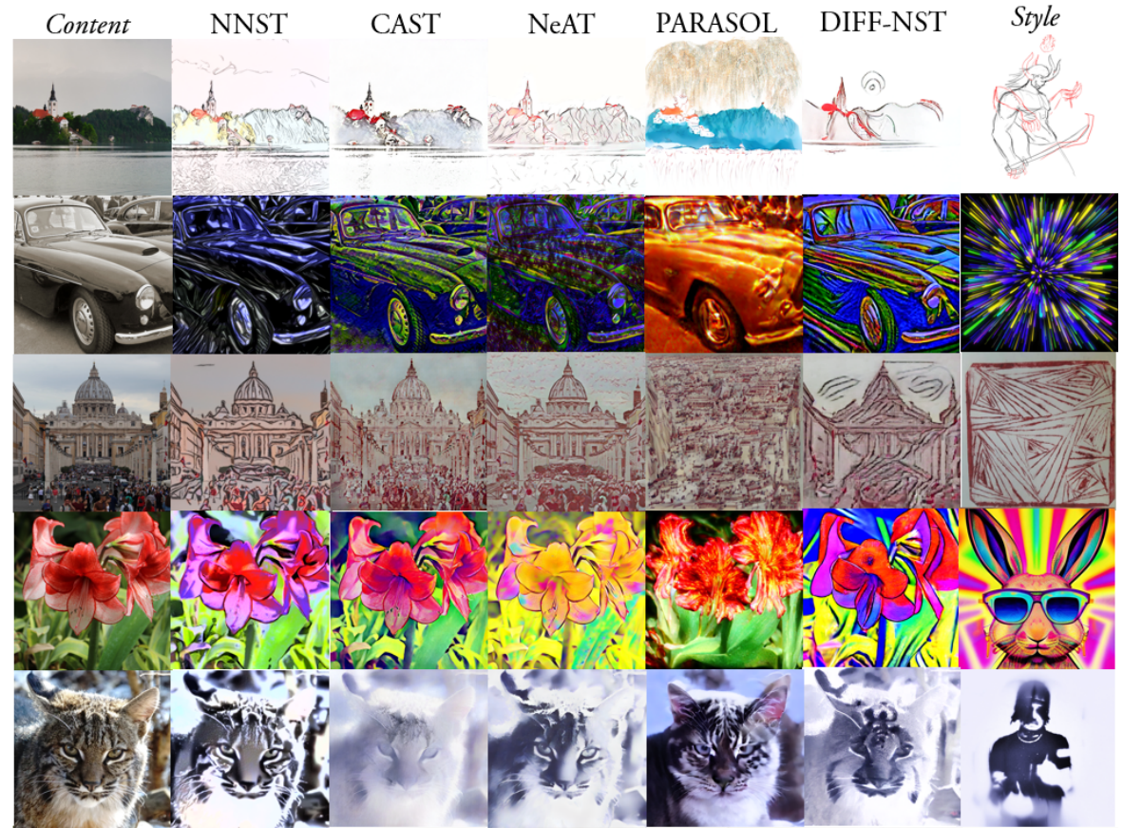
End of 2nd year - Dan Ruta
DIFF-NST: Style transfer with Diffusion models

